Slide 1
Effects of COVID-19 on San Francisco population
By DFT (Racheal, Elijah and Mark)

Slide 2
Racheal
Bachelors degree in Biology from UMass Boston
I am a Lab Technician that specializes in Plasmid DNA extractions.
I don’t know how I got here, I just followed the will of God for my life.
Free time? What free time?: I like to take naps, teach kids at church, sing and dance.
Favorite fruit is watermelon

Slide 3
Elijah
AS in science from New Mexico Military Institute
I am a CNC machine operator for Sauer Machining LLC
I am an avid reader and podcast listener and love to go in-depth in to the newest technologies and fields as well as a good Tolkien novel.
Peach_ specifically my hometown Fredericksburg peaches

Slide 4
Mark
Senior year in computer and information science BS.
IT Support Engineer for the past 4 years. Prior to the COVID-19 shutdown, I worked for PCC Structurals Inc which specializes in Jet Engine Manufacturing worldwide and I was one of the people in charge of 2 big manufactures.
I enjoy playing the piano and worship God with it in my free time, get together with my friends on the weekend. We hangout, watch movies and play games. So much fun.
I adore bananas. I’m known by “The king of bananas” among my friends and family. The sweetest fruit on the plant that everybody loves.

Slide 5

Background
Concern for homeless population
How COVID-19 affected them
What resources did they have
Datasets

Slide 6
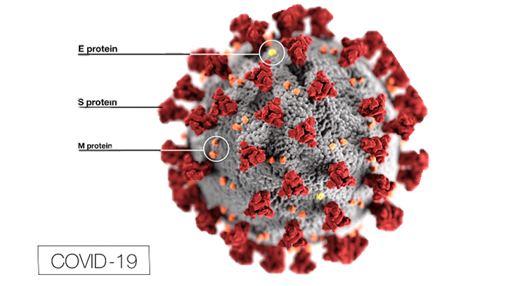
What is COVID-19
COVID-19 is caused by a coronavirus
WAIT!! What is a coronavirus?
Coronaviruses are viruses that are name fir the crown-like spikes on their surfaces.
There are coronaviruses that cause disease in humans and in animals.
Sometimes animal corona viruses evolve and become a new human coronavirus.
For example SARS from 2003 and now COVID-19

Slide 7
What is COVID-19
It is caused by a novel coronavirus, named Severe Acute Respiratory Syndrome coronavirus 2 (SARS-CoV-2).
It was identified as the cause of an outbreak of respiratory illness first detected in Wuhan China in 2019.
The illness caused by the virus has been named coronavirus disease 2019 (COVID-19).

Slide 8
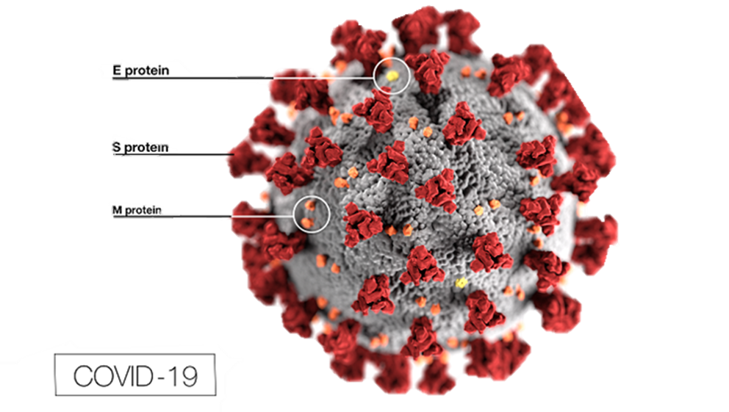
What is COVID-19
SARS-CoV-2 is presumed to have been transmitted through bats, but this has not been confirmed. So the origin is still unknown
There is currently no vaccine for coronaviruses.

Slide 9
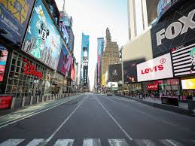
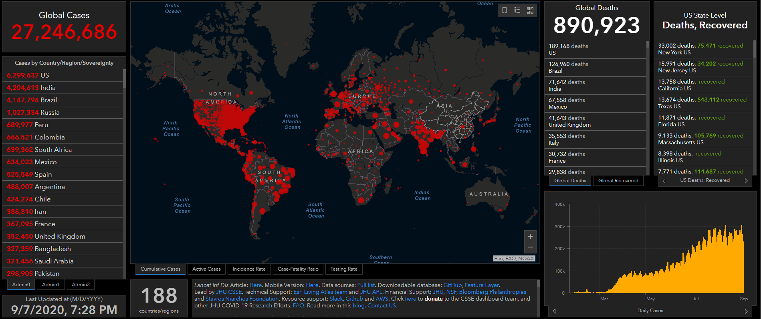
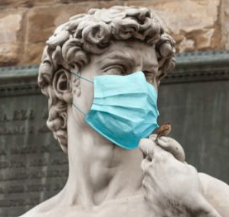
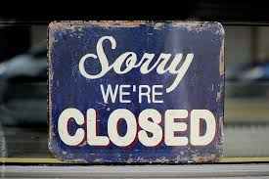
IMPACT OF COVID-19
Notes:
Over 20 million cases, over 700k death worldwide as of Aug 2020.
Every country was affected, in most ways, (economically, financially, socially etc.)

Slide 10
Methods
What we did to :
Gather/find data
Manipulate/wrangle data
Create new variables
Important variables and their summary statistics
Homeless population (cumulative and percentage) – 246 COVID-19 cases
General population (cumulative and percentage) - 6177 COVID-19 cases
Rooms occupied
County – San Francisco

Slide 11


Data Sources
Kaggle
California.gov
Census.gov

Slide 12




Software used

Slide 13
Results

Slide 14
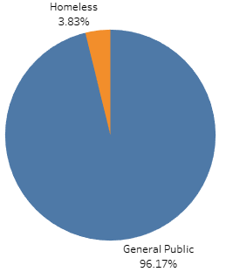
QN1: Are the homeless cases equal to the general public cases.
The homeless cases are not equal to the general public cases. In fact that the homeless cases are only 3.8% of the positive COVID19 cases observed in San Francisco.

Slide 15

Not affected the same?!
How hard then did the homeless population get affect by
the covid-19 pandemic ?

Slide 16



QN2: How hard then did the homeless population get affect by the covid-19 pandemic ?
Online sources have stated that the homeless population was hit 80% harder compared to the general public in the last few months?
Is this true?

Slide 17
QN2: Online source has stated that the homeless population was hit 80% harder compared to the general public?
We ran Two Proportion z-test analysis.
Two Proportion z-test determines the proportions of the cases in each population so we can compare the difference in percentage in the total population.
We have discovered that 2.51% of the homeless population were impacted. And 0.71% of the general public population were impacted.

Slide 18
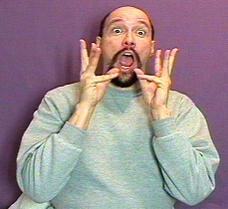
QN2: Online source has stated that the homeless population was hit 80% harder compared to the general public?
Using the Percentage Difference Calculator we concluded that the Homeless population was hit 112% harder than the general public.

Slide 19
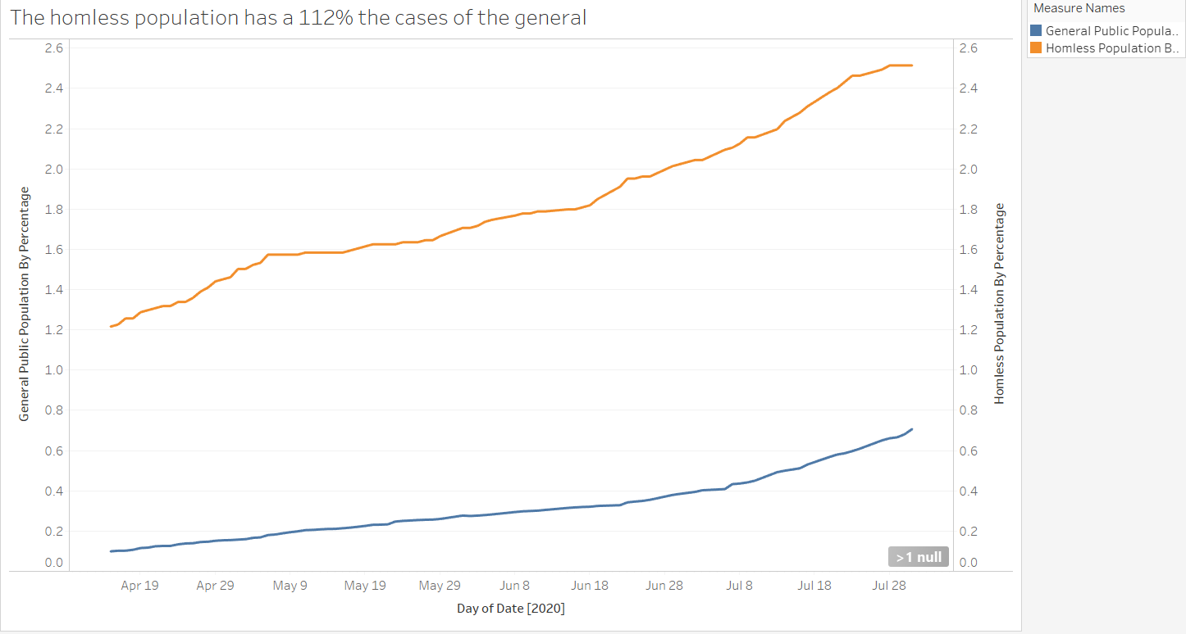

Slide 20



Impact on the Homeless Shelters
Since we observed a huge impact, we wanted to check the homeless shelter, if they were affected by the increased numbers of cases.

Slide 21
QN3: Have the rooms available in the homeless shelters been affected by the COVID-19 cases then?
We ran Independent Chi-Square analysis.
Independent Chi-Square determines whether “homeless cases" is influencing "rooms availability".
We have discovered that, as the homeless cases increased, the rooms available decreased especially in the later months of June and July.

Slide 22
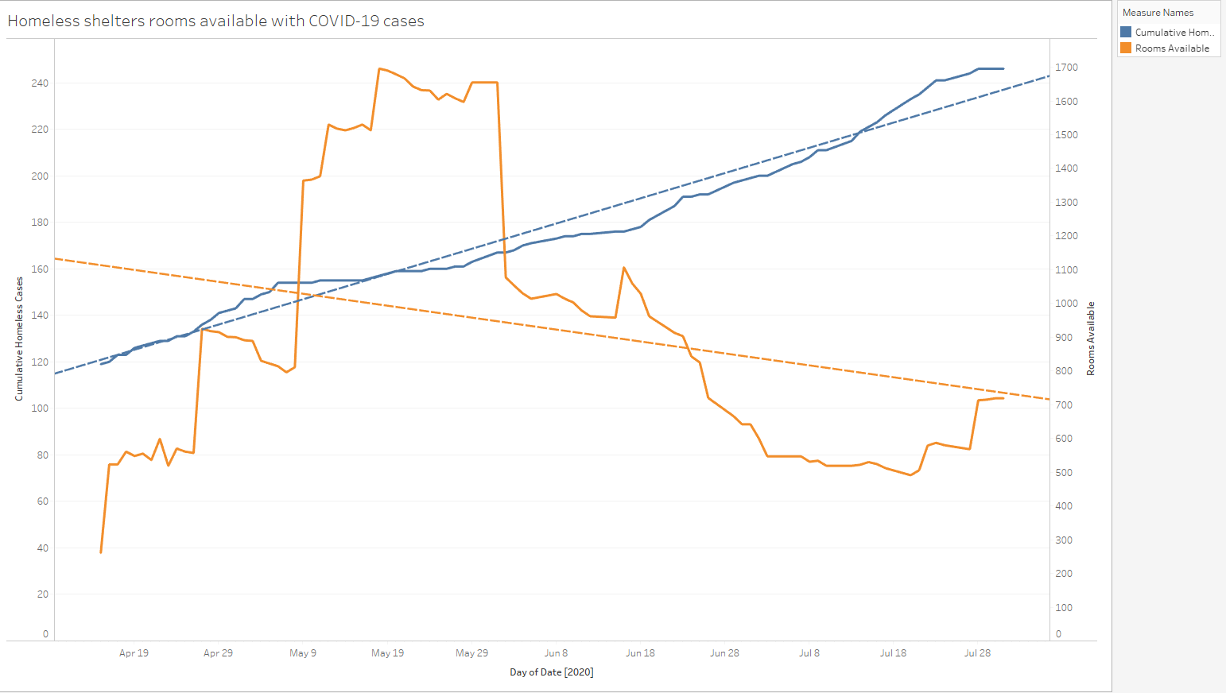

Slide 23
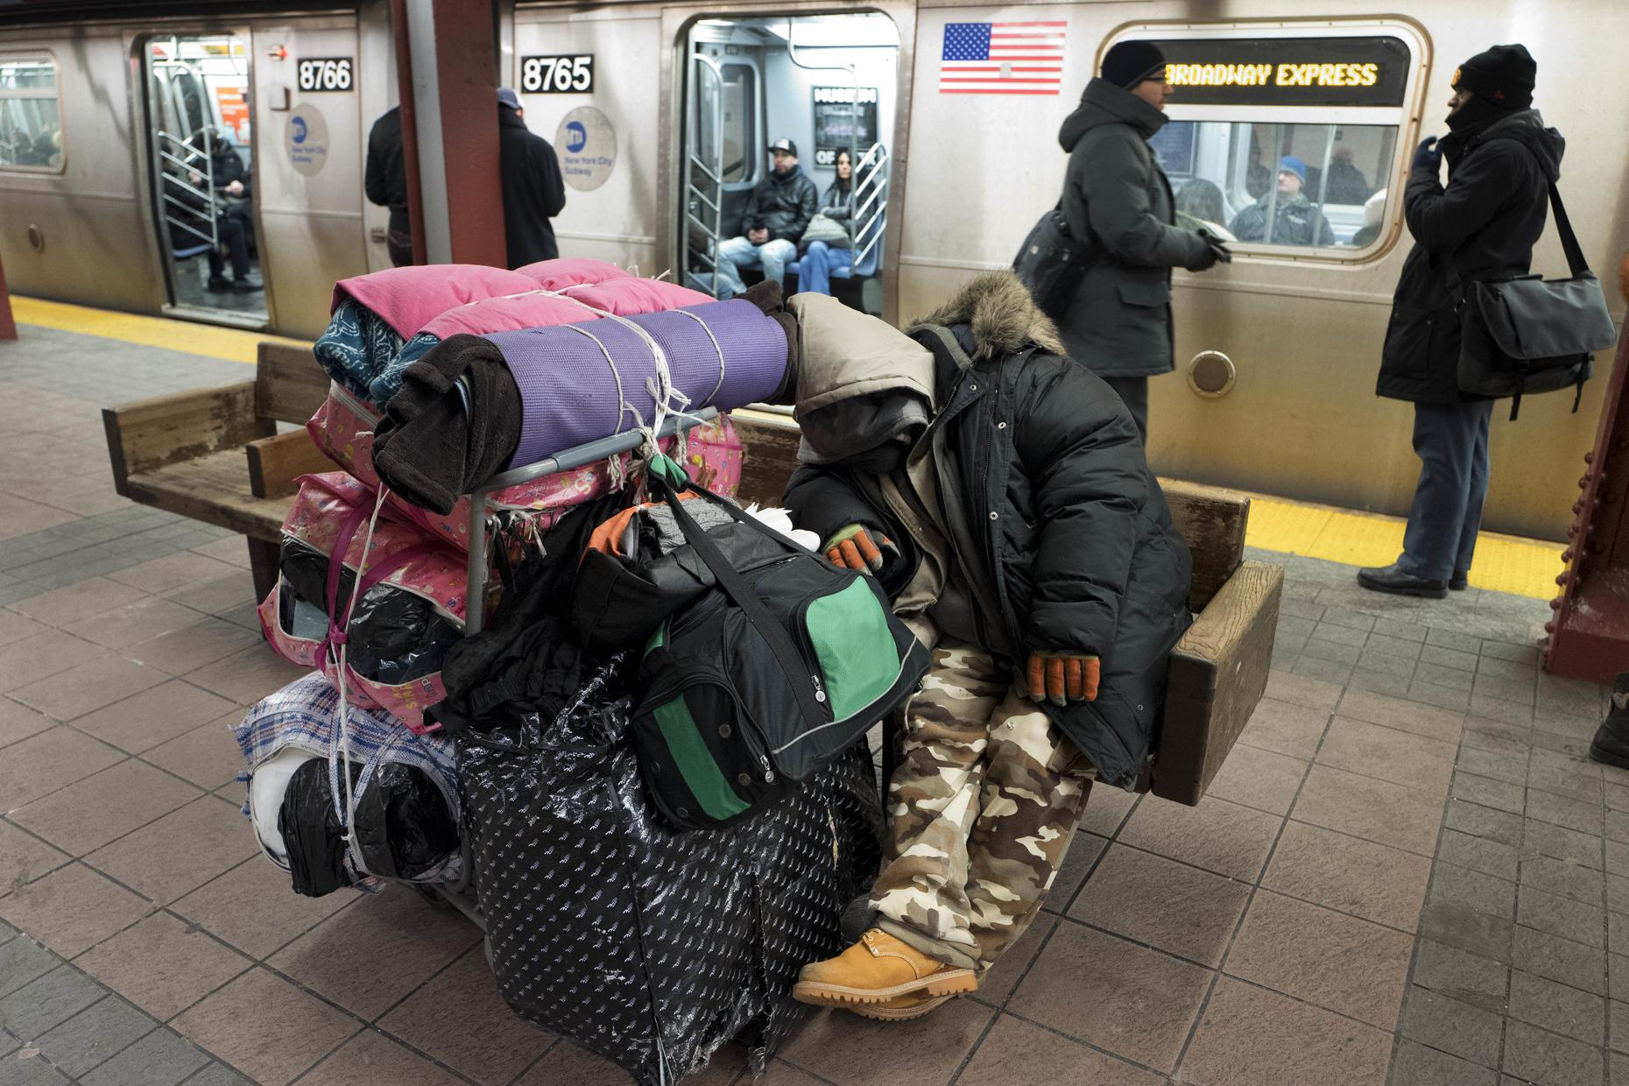
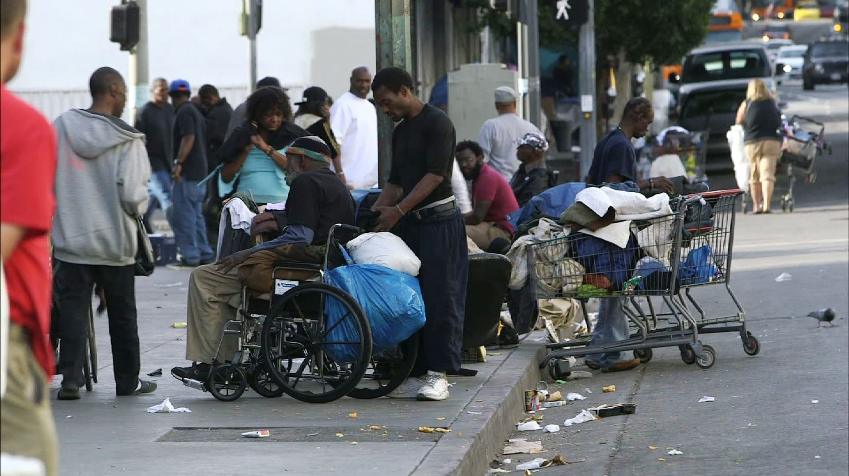
QN4: Are the number of homeless cases affecting the general public. Are the homeless spreading COVID19 because they have no rooms available?
We ran linear regression predictive analysis.
Linear regression explains the relationship between the homeless population and the general public population cases.

Slide 24
QN4: Are the number of homeless cases affecting the general public. Are the homeless spreading COVID19 because they have no rooms available?
We have discovered that this model accounts for 92% of an overlap in the 2 population cases. We see that there is a relationship between the two populations cases hence, there is a possibility that the homeless are contributing to the spread of COVID-19 to the general public.
How ever, we found a lot of variance, and outliers.

Slide 25
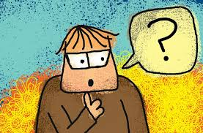
QN5 : How is San Francisco compared to the other counties?

Slide 26
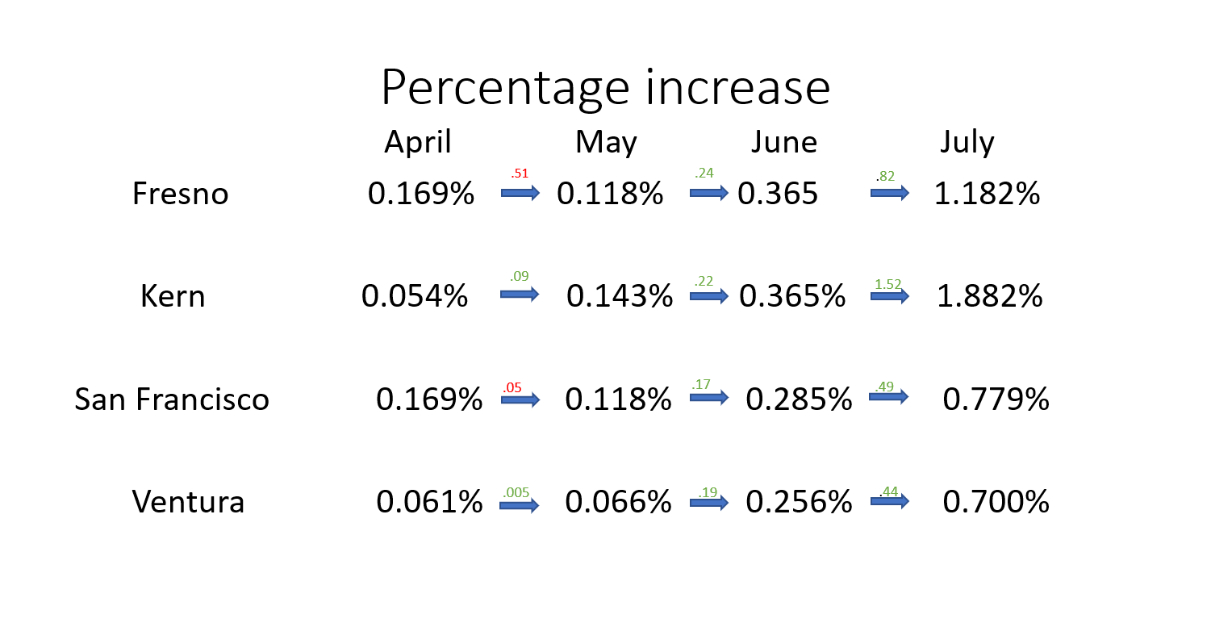

Slide 27
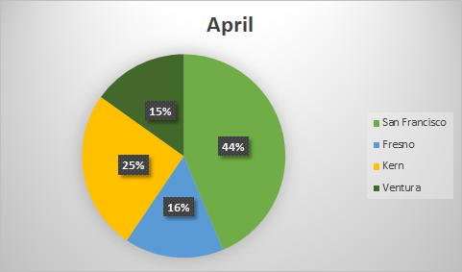
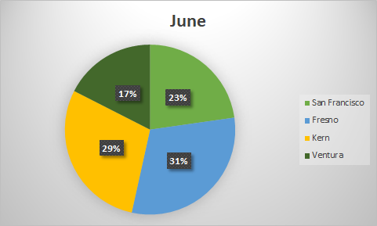
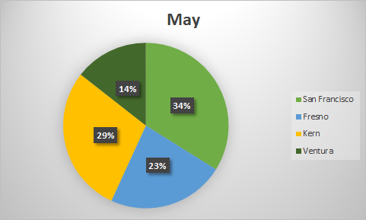
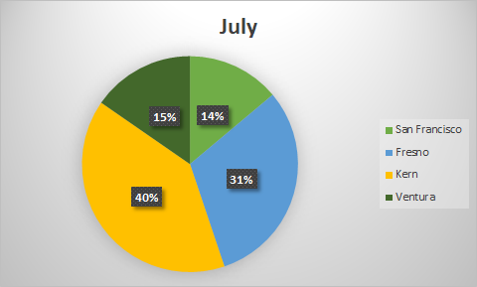
Change in cases % by month

Slide 28
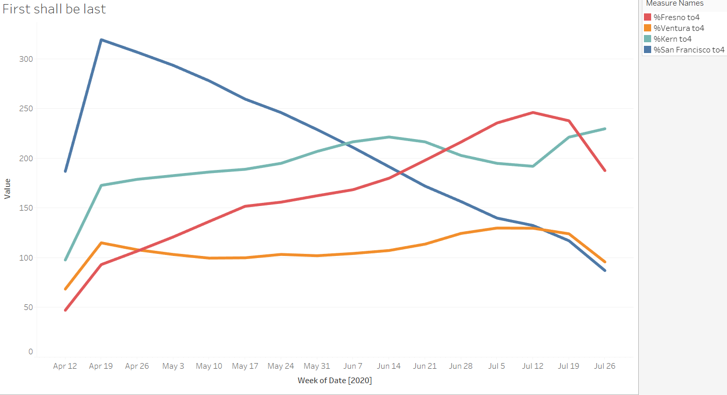
First shall be last

Slide 29
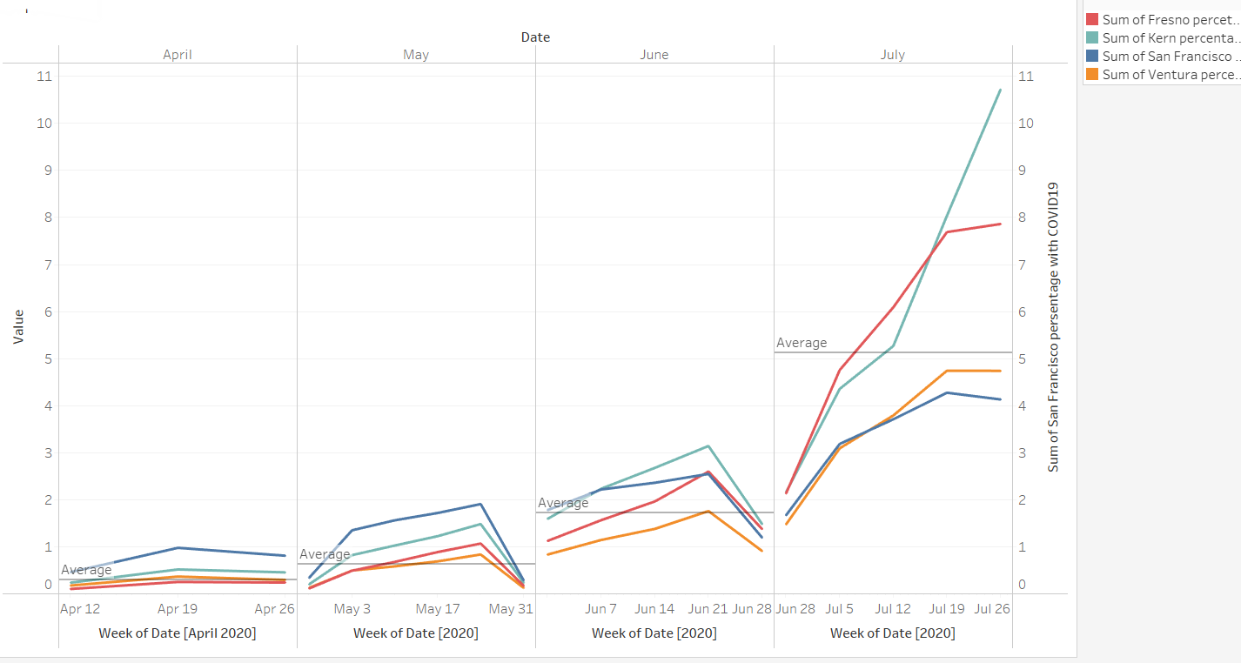
How the counties dealt with COVID-19 by month

Slide 30
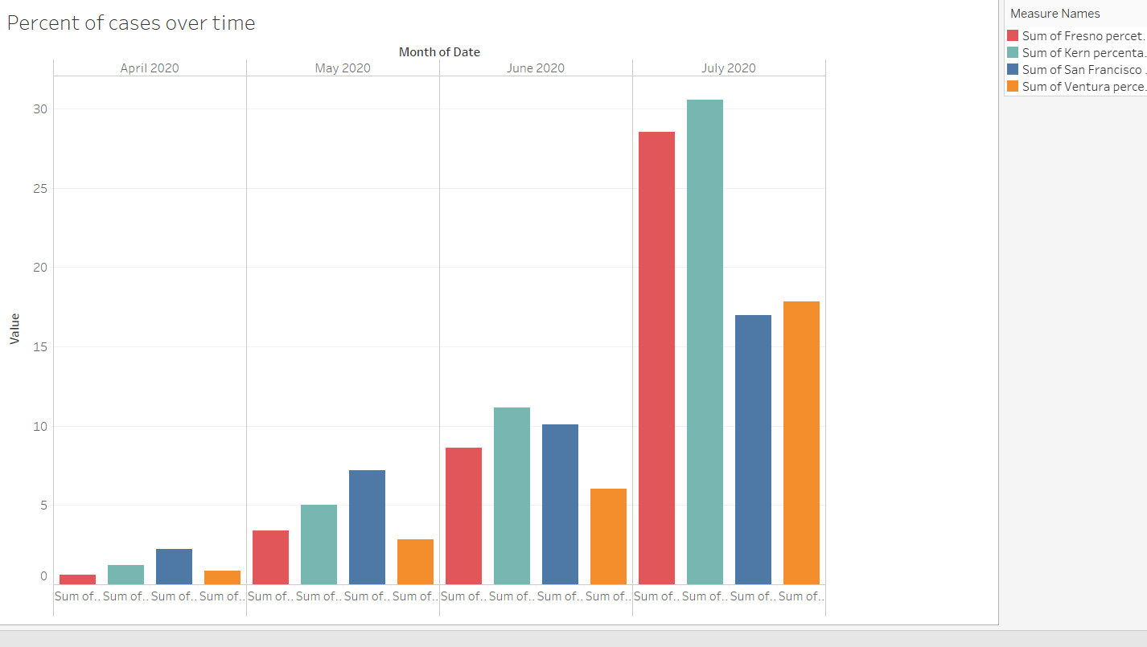
Percent of cases over time

Slide 31
Summary
Here is a summary of our discoveries :
Only 3.8% of COVID19 cases in San Francisco are homeless
2.5% of the homeless population has been affect by COVID19
Only 0.7% of the general public population has been affected by COVID19
Homeless population has been affected 111% harder than the general public
Towns that started out with fewer cases were faced wit an exponential growth in COVID19 cases
The homeless population are spreading COVID19 to the general public because they do not have homes and resources.

Slide 32
Conclusions
How do our finding impact the world at large ?
What’s important about this work?
Big picture information

Slide 33
QUESTIONS?

Slide 34
Sources
https://www.cdc.gov/coronavirus/types.html
https://www.cdc.gov/media/subtopic/images.htm
https://coronavirus.jhu.edu/map.html
Percentage Difference Calculator- https://www.calculatorsoup.com/calculators/algebra/percent-difference-calculator.php

